Slide 1

Domain-Driven Design
Implementation Patterns and Considerations in .NET
Part 1: Concepts
DX/TED
Steve Bohlen
Principal Software Engineer
& Technical Evangelist
sbohlen@gmail.com http://blog.unhandled-exceptions.com @sbohlen

Slide 2










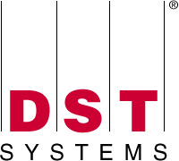




















Titanium Sponsors
Platinum Sponsors
Gold Sponsors

Slide 3
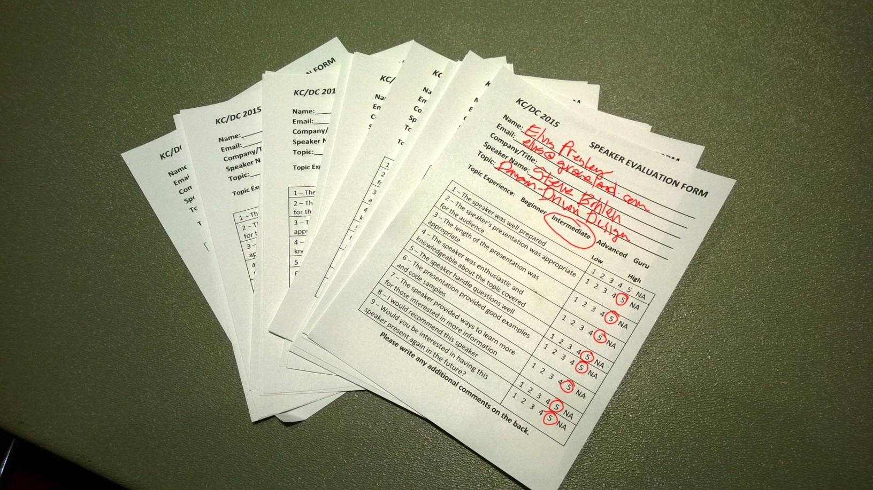

Slide 4
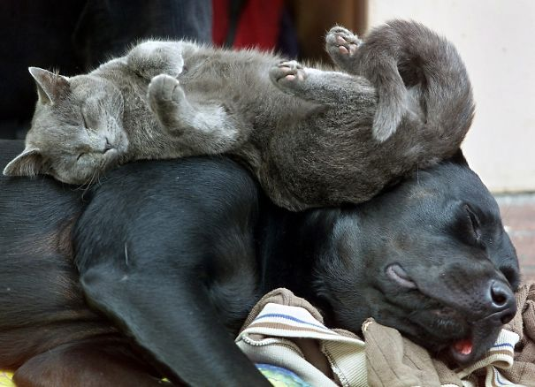

Slide 5
Who am I?
…and why should you care?
Steve Bohlen
I Read Books + Write Software
vs. “Read Software + Write Books” ☺
Blog, Screencast, Speak, Share, Learn

Slide 6

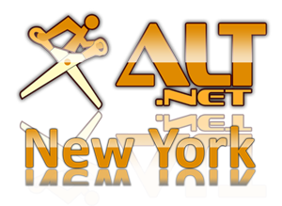

Steve Bohlen
Over 20 years as a software developer
LISP, Delphi, C/C++, VB, VB.NET, Java, Ruby, C#, JavaScript
Principal Software Engineer, Microsoft
Co-Founder, NYC Alt.Net User Group
http://nyalt.net
Co-Organizer, NYC DDD User Group
http://dddnyc.org
Contributor: various OSS projects
NHibernate http://www.nhforge.org
NDbUnit http://www.googlecode.com/ndbunit
Spring.NET http://www.springframework.net
blog: http://blog.unhandled-exceptions.com
e-mail: sbohlen@gmail.com
twitter: @sbohlen
Membership: ASP Insiders, C# Insiders, Telerik Insiders, INETA Board of Directors
Alumni

Slide 7

I am a
employee…
…but these thoughts are my own!

Slide 8
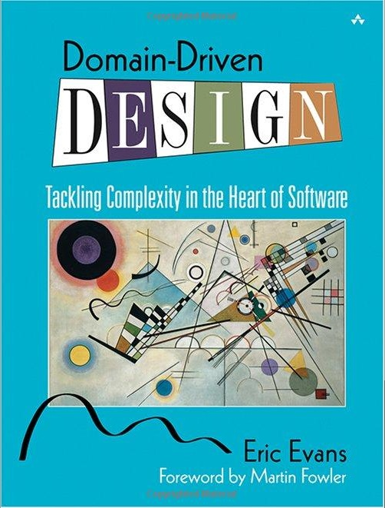

http://bit.ly/evans-ddd-book

Slide 9
What I’ve Learned about DDD Since the Book
http://bit.ly/evans-ddd-since-the-book

Slide 10
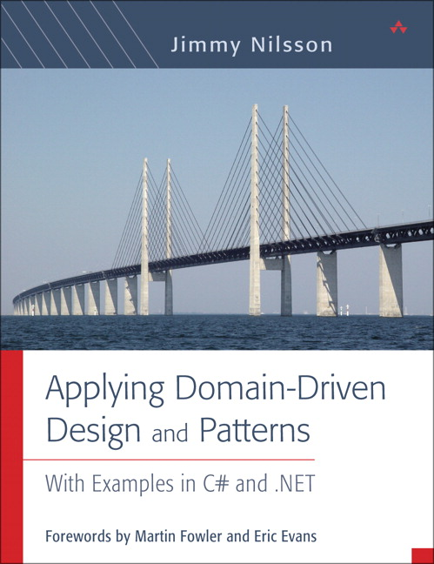
http://bit.ly/nilsson-ddd-book

Slide 11
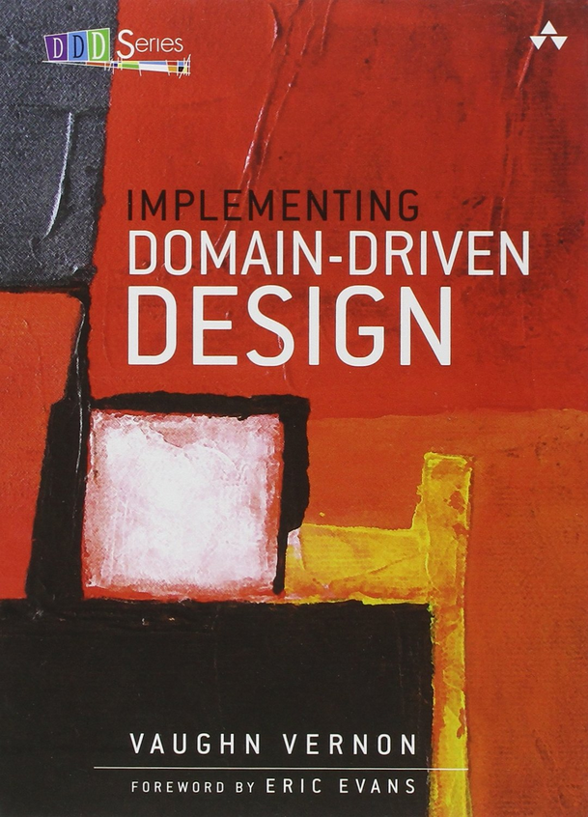
http://bit.ly/vernon-ddd-book

Slide 12
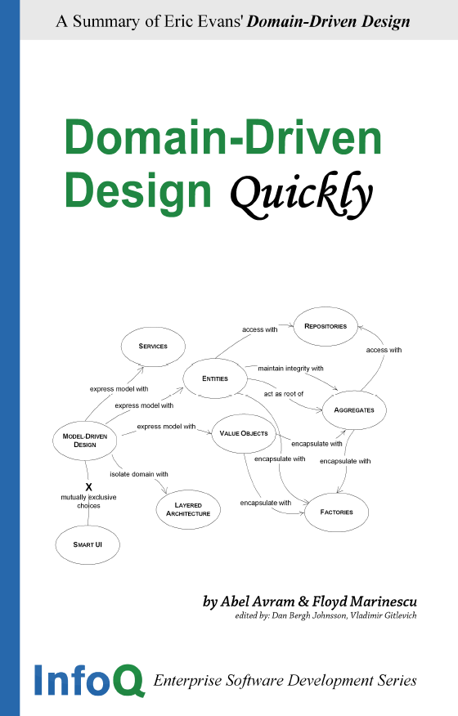
http://bit.ly/infoq-domain-driven-design

Slide 13
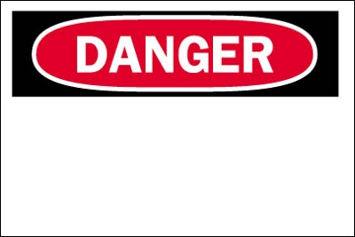
Opinions Ahead

Slide 14
Agenda
Part 1: Concepts: What is DDD and Why Should I Care?
Part 2: DDD Model Building Blocks in .NET
Domain Entities
Domain Value Objects
Domain Repositories
Domain Services
Domain Validation
General DDD Coding Anti-Patterns

Slide 15
Introducing Domain-Driven Design

Slide 16
The Role of Patterns in Software
Once: it’s a fluke, twice: its coincidence, three times: it’s a pattern
Discovered (observed), not Invented
Except for their name ☺
Elevate effectiveness of our communication
A ‘shorthand’ for more complex ideas
Only effective if we all agree on the semantic meaning of the elements of the Pattern Language!

Slide 17
Software Pattern Language Hierarchy
Solution Design
Software Architecture
Software Construction
Programming Languages
Fowler POEAA
Evans DDD
GOF Design Patterns
C#, .js

Slide 18
Observations
Writing software is actually pretty straightforward
Determining what to write is hard!
The Key to success is understanding the Problem Domain intimately
The words we choose to express concepts convey rich meaning and it matters a lot which words we choose

Slide 19


Building the Thing Right…

Slide 20

…vs. Building the Right Thing!
…Right!

Slide 21

Language Matters

Slide 22
weeping
grieved
morbid
bereaved
gloomy
despondent
heartbroken
forlorn
bitter
pensive
glum
sad
cheerless
hurting
dismal
dejected
morose
troubled
downcast
somber
disconsolate
dejected
sorry
woebegone

Slide 23
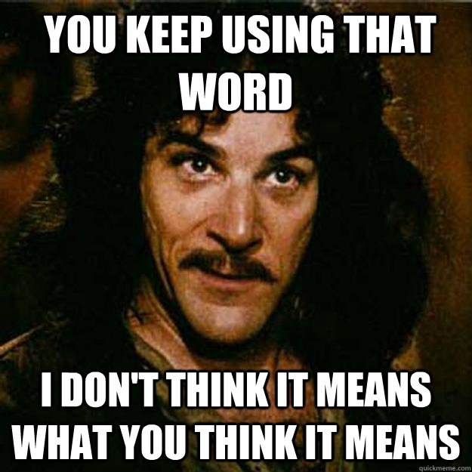

Slide 24
Three hardest problems in Software Engineering
Naming things
Off-by-One errors

Slide 25
Ubiquitous Language
Developers and Business People move in different worlds
Different languages to express our ideas
F R I C T I O N ! ! !
What if we all spoke the same language?
Our common language would be…ubiquitous ☺

Slide 26
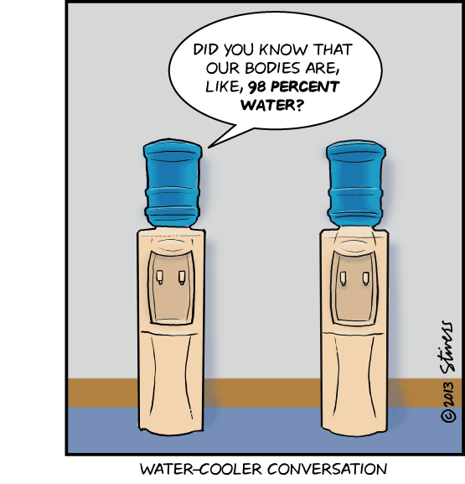
The Watercooler Conversation
Spontaneous Discovery
Unplanned Learning
Unexpected Knowledge

Slide 27
Ubiquitous Language
Used everywhere
In conversations with the Business Stake-Holders / SMEs / Domain Experts
classes, methods, variables, etc.
Even in Tests
Behavior-Driven Development!
Conversing using the language enables…
‘Solution smells’ detected by Domain Experts
Discovery of new domain concepts by developers
Shared learning by all involved – ENGINEERING and BUSINESS!
Collaborative and collective evolution of Knowledge

Slide 28
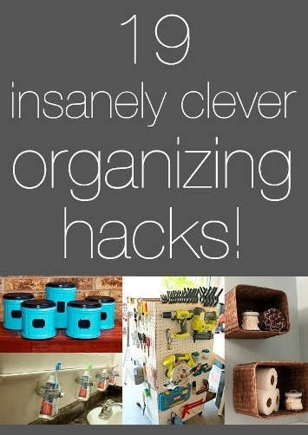

Organizing Strategies

Slide 29
Organizing Strategies
Aggregates
Bounded Contexts
Context Maps
Anti-Corruption Layers

Slide 30

Aggregates
‘Parent Entity’
Controls all access to children objects
Simplifies interaction with complex object graphs
‘Gateway’ to richer objects
Consistency Boundary

Slide 31
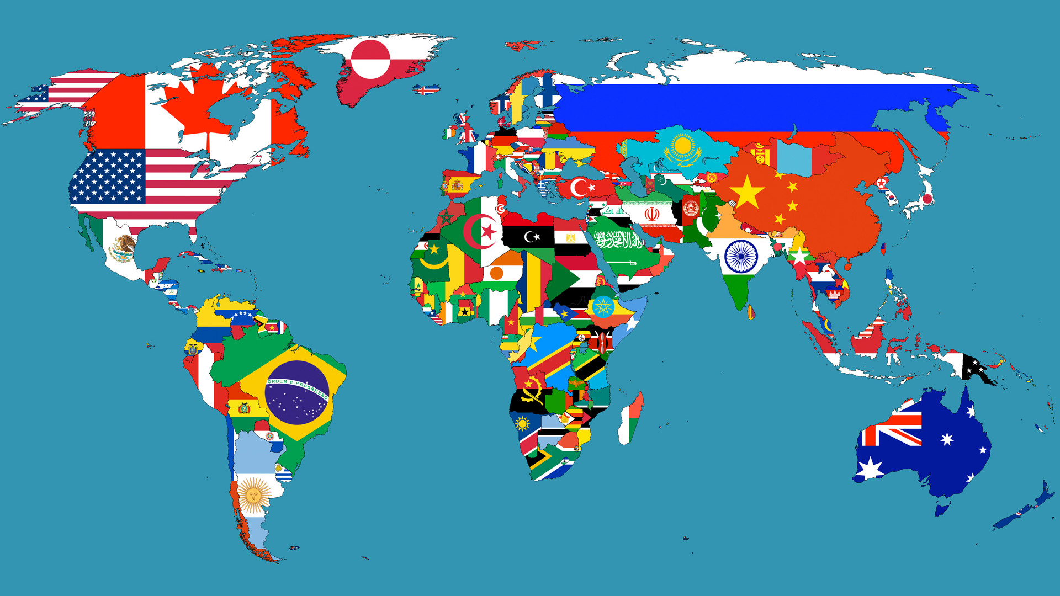
Bounded Contexts

Slide 32

Bounded Contexts

Slide 33
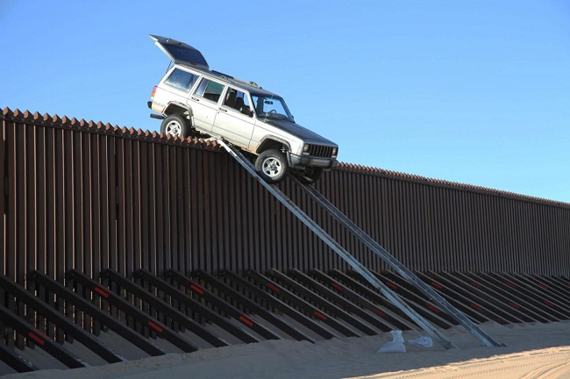
Crossing Bounded Contexts

Slide 34

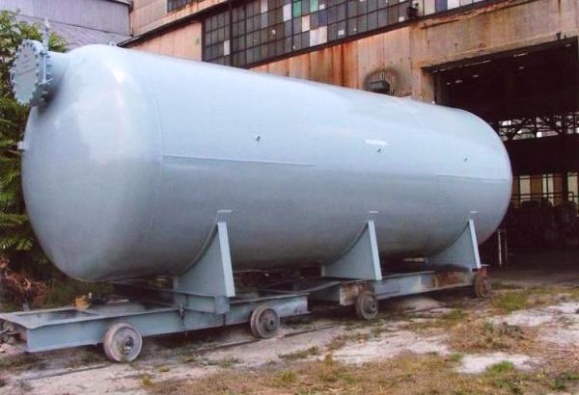
Bounded Contexts
Semantic Meaning is all about Context

Slide 35

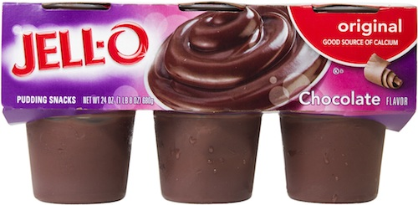
Context Matters: The ‘Pudding’ Problem

Slide 36
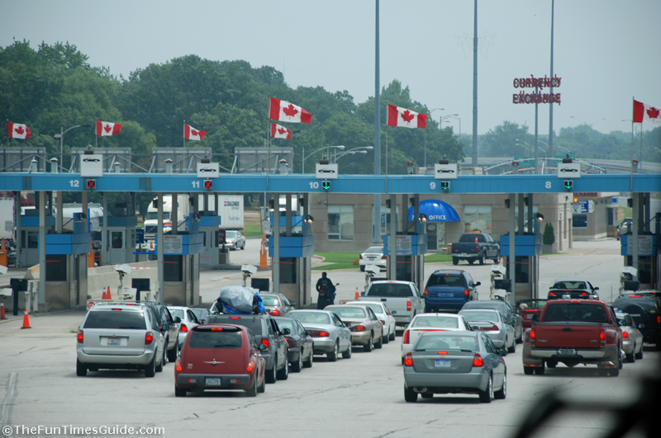
Context Maps

Slide 37
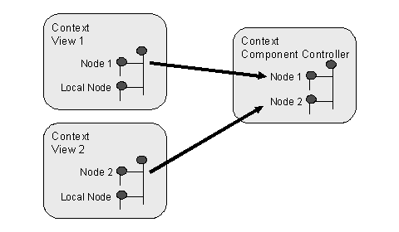
Context Maps
When we need to communicate across Bounded Contexts
Translation of ideas
Not always bi-directional

Slide 38

The Big Ball of Mud Pattern

Slide 39

Anti-Corruption Layers
Protect your self from the Big Ball of Mud!
Isolate the parts of your system that change from the parts that are stable
Not just for ‘messy code’, but for code that changes for different reasons or at different rates

Slide 40
Organizing Strategies

Slide 41
Breathe!

Slide 42
Domain-Driven Design
Implementation Patterns and Considerations in .NET
Part 2: Code and Implementation
DX/TED
Steve Bohlen
Principal Software Engineer
& Technical Evangelist
sbohlen@gmail.com http://blog.unhandled-exceptions.com @sbohlen

Slide 43
Domain Model Building Blocks

Slide 44
Exploring Domain Model Building Blocks
Entities
Value Objects
Repositories
Services
Validation

Slide 45

Entities

Slide 46
Coding DDD Entities Distilled
Identity Equality
Objects are just reference-equal by default in .NET
Equals, GetHashCode, IEquatable<T>
Identity Comparison
Control of Access to Children Objects within the aggregate
Customer.AddOrder(theOrder);, Customer.RemoveOrder(theOrder);
Not Customer.Orders.Add(theOrder);
Infrastructure-Ignorant
Persistent-Ignorant, UI-Ignorant, etc.

Slide 47
Challenges with DDD Entities
Do we expose Identity value as a property?
Isn’t that a persistence-concern?
Providing a setter means the ‘identity’ of my entity can be changed by something external to it (bad!)
Are General Property Setters/Getters a smell?
Means your domain is trending towards DTO-hell
Entities as just property-containers for data
Non-Meaningful names for things!

Slide 48
Exploring Entities in Code

Slide 49


Value Objects

Slide 50
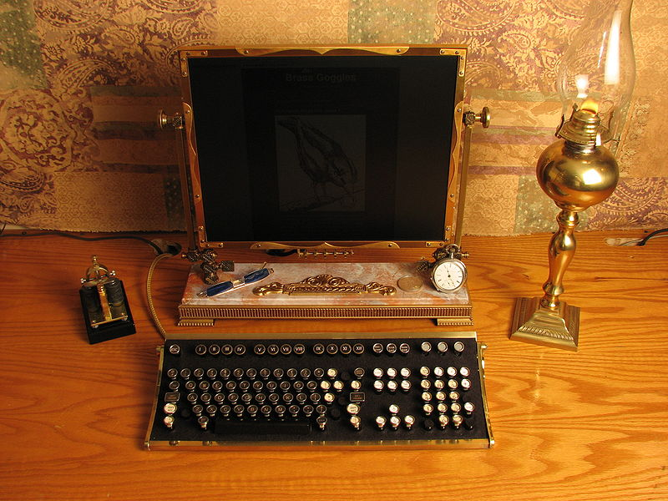
Anti-Pattern: Primitive Obsession

Slide 51
Understanding Entities and Value Objects
public class Name
{
public string Firstname {get; set;}
public string Lastname {get; set;}
}
public class Customer
{
public int Id { get; set;}
public Name FullName {get; set;}
public Address ShippingAddress {get; set;}
public Address BillingAddress {get; set;}
}
public class Customer
{
public int Id { get; set;}
public string Firstname {get; set;}
public string Lastname {get; set;}
public int BuildingNumber {get; set;}
public string Street {get; set;}
public string City {get; set;}
public string State {get; set;}
public string PostalCode {get; set;}
}
public class Address
{
public int BuildingNumber {get; set;}
public string Street {get; set;}
public string City {get; set;}
public string State {get; set;}
public string PostalCode {get; set;}
}

Slide 52
Coding DDD Value Objects Distilled
Immutable
After construction, no changes to the object
Read-Only Properties
Value-Equality
Equals, GetHashCode, IEquatable<T>
Property-by-Property comparison!

Slide 53
Challenges with DDD Value Objects
Tedious to write boilerplate IEquatable<T> implementation code by hand every time
If immutable, how do we modify one?
Not entirely a trick question ☺
If no identity, how do we persist them????
Deconstruction into basic data types

Slide 54
Exploring Value Objects in Code

Slide 55
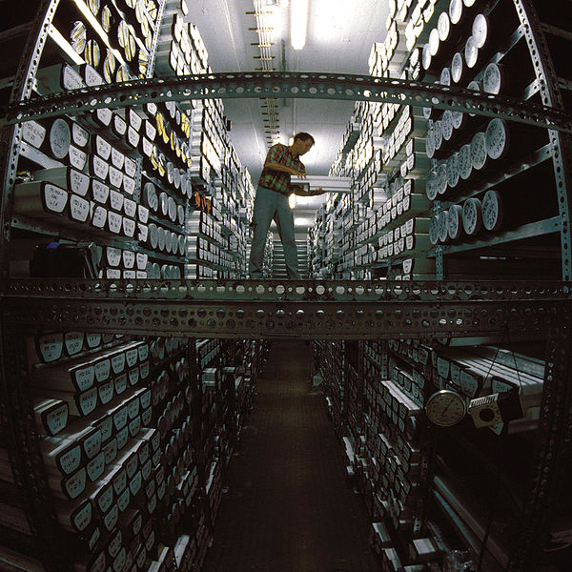
Repositories

Slide 56
Coding DDD Repositories Distilled
Support the need to interact with collections of Domain Model objects
Abstract Domain Model from specific Persistence
Abstract the act of query/retrieval
Do so in a Domain-Centric Way
(CustomerRepository.GetById(int id) is NOT domain-centric!)

Slide 57


Who’s ‘Repository Pattern’ do we mean?

Slide 58
Challenges with DDD Repositories
If no persistence in the Domain Model, how do we reference repositories in there?
Abstraction/indirection
Repository Boundary blurring
OK for query constructs to come from outside?
repos.GetBySpecification(Specification spec);
OK for Specification to be tied to implementation?
repos.GetByCriteria(DetachedCriteria crit);
OK for lazy-executed queries to be returned?
public IQueryable<Customer> GetCustomers()
Guarding against Repository API-bloat
The repository is dead, long live the repository!

Slide 59
Exploring Repositories in Code

Slide 60

Services

Slide 61
Coding DDD Services Distilled
Actions/Behaviors not clearly belonging to a single Entity
Injected into Entities (?)
Operating Autonomously from Entities
Often Stateless, sometimes Stateful

Slide 62
Challenges with DDD Services
Is having Services just to inject into Entities an anti-pattern?
Order order = new Order(taxservice);
double cost = Order.TotalWithTax();
If Services coordinate Entity interaction, who news-up the service?
Having all behavior expressed in Services and none in Entities is a DDD anti-pattern
Or is it? And why?

Slide 63
Exploring Services in Code

Slide 64

Validation

Slide 65
Coding DDD Validation Distilled
Validation is often a stand-in for ‘business rules’
bool CanShipOrder();
Distinguish between persistence validation and business action validation
Rarely the same thing!
Entity Validation
Entities can be valid for some cases and also invalid for others
Place an order (if valid customer w/ a valid account)
Ship an Order (if valid account and under credit limit)
Value Object Validation
Prevent VO from entering an invalid state in the first place!

Slide 66
Challenges with DDD Validation
Validation without ‘for what?’ is pointless
bool IsValid(); //???
Validation Frameworks tend to assume validation is for persistence
Does NOT mean cannot be repurposed for Domain Validation!
Where does validation happen if it requires collaboration between multiple Entities?
bool order.CanShipTo(customer);
bool customer.CanShip(order);
bool shippingValidator.CanShip(customer, order)
Anemic Domain Model Anti-Pattern?

Slide 67
Exploring Validation in Code

Slide 68
Common DDD Coding Anti-Patterns
DDD Constructs with ‘role-suffixes’
Not…
CustomerEntity
AddressValueObject
CustomerRepository
ShippingService
OverdueOrderSpecification
Repository as glorified DAL
repository.Get(int id)
repository.Save(Customer c)
repository.Delete(Customer c)
repository.Update(Customer c)

Slide 69
Common DDD Anti-Patterns
Anemic Domain Model
The DTO pattern
Exposed DAOs
Repository ‘leakage’ into the domain
‘Fat’ Service Layer
Separation of Data and Behavior
Technical terms sneak into the Domain Model
Slightly-less-than-ubiquitous-language

Slide 70
Some Criticisms of DDD
Jeremy Miller: “Jargon Explosion”
Aggregates, Entities, Value Objects, Bounded Contexts, Anti-Corruption Layers, Oh My!
Singleton, Observer, State, Strategy, Adapter, Bridge, Facade
Rob Conery: “Bland, Generic Terms”
Singleton, Observer, State, Strategy, Adapter, Bridge, Facade

Slide 71
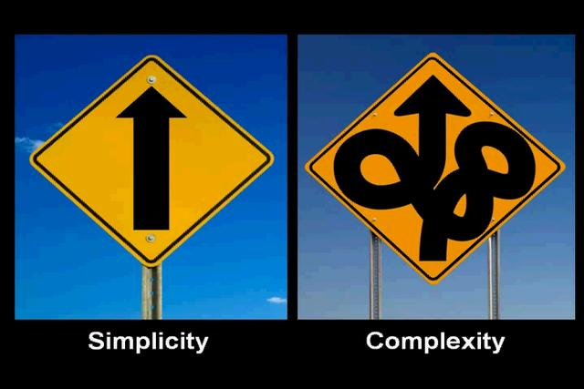
Should I do DDD?

Slide 72
Discussion
References
Domain Language
http://www.domainlanguage.com
Domain Driven Community
http://www.domaindrivendesign.org

